Slide 1
NumPy & Pandas

Slide 2
COURSE LEARNING RATIONALE (CLR) | The purpose of learning this course is to:
CLR-1: | Think and evolve with a logic to construct an algorithm and pseudocode that can be converted into a program
CLR-2 : | Utilize the appropriate operators and control statements to solve engineering problems
CLR-3 : | Store and retrieve data in a single and multidimensional array
CLR-4 : | Create custom designed functions to perform repetitive tasks in any application
CLR-5 : | Create basic Abstract Data Types with python
CLR-6 : | Create applications using suitable python library functions for solving datascience problems

Slide 3
Course Learning Outcomes (CLO) | At the end of this course, learners will be able
CLO-1: | To solve problems through computer programming. Express the basic data types and variables in C
CLO-2: | To use appropriate data types in simple data processing applications. To create programs using the concept of arrays
CLO-3: | To create string processing applications with single and multi-dimensional arrays
CLO-4: | To create user defined functions with required operations. To implement pointers in applications with dynamic memory requirements.
CLO-5: | To create programs using the python data types, loops, control statements for problem solving
CLO-6: | To implement the suitable python library based solutions for solving statistical problems in data science

Slide 4
ndarray ndarray or numpy.array (alias) is the basic data format
a = numpy.array([2,3,4]) Make array with list or tuple (NOT numbers)
a = numpy.fromfile(file, dtype=float, count=-1, sep=‘ ’)
dtype Allows the construction of multi-type arrays
count Number of values to read (-1 == all)
sep Separator
To generate using a function that acts on each element of a shape: numpy.fromfunction(function, shape, **kwargs)

Slide 5
Built in functions
a = numpy.zeros( (3,4) )
array([[ 0., 0., 0., 0.], [ 0., 0., 0., 0.], [ 0., 0., 0., 0.]])
Also numpy.ones and numpy.empty (generates very small floats)numpy.random.random((2,3))
More generic : ndarray.fill(value)
numpy.putmask() Put values based on a Boolean mask array (True == replace)

Slide 6
Arange
Like range but generates arrays:
a = np.arange( 1, 10, 2 )
array([1, 3, 5, 7, 9])
Can use with floating point numbers, but precision issues mean better to use: a = np.linspace(start, end, numberOfNumbersBetween)

Slide 7
ndarray
Options set with numpy.set_printoptions, including
darray.ndim Number of axes (dimensions)
ndarray.shape Length of different dimensions
ndarray.size Total data amount
ndarray.dtype Data type in the array (standard or numpy)
print(array) Will print the array nicely, but if too larger to print nicely will print with "…," across central points.
Options set with numpy.set_printoptions, including numpy.set_printoptions(threshold = None)

Slide 8
Indexing
Data locations are referenced using [row, col] (for 2D):
arrayA[1,2] not arrayA[1][2]
This means we can slice across multiple dimensions, one of the most useful aspects on numpy arrays: a = arrayA[1:3,:] array of the 2nd and 3rd row, all columns. b = arrayA[:, 1] array of all values in second column.
You can also use … to represent "the rest": a[4,...,5,:] == a[4,:,:,5,:].

Slide 9
Percentile
numpy.percentile(a, q, axis=None,iterpolation=’linear’)
a: array containing numbers whose range is required q: percentile to compute(must be between 0 and 100) axis: axis or axes along which the range is computed, default is to compute the range of the flattened array interpolation: it can take the values as ‘linear’, ‘lower’, ‘higher’, ‘midpoint’or ‘nearest’.

Slide 10
Example:
>>> import numpy as np
>>> A=np.array([[10,14,11,7,9.5,15,19],[8,9,17,14.5,12,18,15.5],
[15,7.5,11.5,10,10.5,7,11],[11.5,11,9,12,14,12,7.5]])
>>> B=A.T
>>> a=np.percentile(B,27,axis=0, interpolation='lower')
>>> b=np.percentile(B,25,axis=1, interpolation='lower')
>>> c=np.percentile(B,75,axis=0, interpolation='lower')
>>> d=np.percentile(B,50,axis=0, interpolation='lower')
>>> print(a)
[ 9.5 9. 7.5 9. ]
>>> print(b)
[ 8. 7.5 9. 7. 9.5 7. 7.5]
>>> print(c)
[ 14. 15.5 11. 12. ]
>>> print(d)
[ 11. 14.5 10.5 11.5]

Slide 11
Variance
The average of the squared differences from the mean. For a dataset, \(X=\{a_1,a_2,\ldots,a_n\) with the mean as \(\overline{x}\), variance is \(\displaystyle Var(X)=\frac{1}{n}\sum_{i=1}^n(a_i-\overline{x})^2\)
numpy.var(a, axis=None, dtype=None, ddof=0)

Slide 12
Example:
>>> import numpy as np
>>> A=np.array([[10,14,11,7,9.5,15,19],[8,9,17,14.5,12,18,15.5],
[15,7.5,11.5,10,10.5,7,11],[11.5,11,9,12,14,12,7.5]])
>>> B=A.T
>>> a = np.var(B,axis=0)
>>> b = np.var(B,axis=1)
>>> print(a)
[ 13.98979592 12.8877551 6.12244898 3.92857143]
>>> print(b)
[ 6.546875 5.921875 8.796875 7.546875 2.875 16.5 19.0625 ]

Slide 13
Standard deviation
numpy.std(a, axis=None, dtype=None, ddof=0)
Example:
>>> import numpy as np
>>> A=np.array([[10,14,11,7,9.5,15,19],[8,9,17,14.5,12,18,15.5],
[15,7.5,11.5,10,10.5,7,11],[11.5,11,9,12,14,12,7.5]])
>>> B=A.T
>>> a = np.std(B,axis=0)
>>> b = np.std(B,axis=1)
>>> print(a)
[ 3.74029356 3.58995196 2.4743583 1.98206242]
>>> print(b)
[ 2.55868619 2.43349029 2.96595263 2.74715762 1.6955825 4.0620192 4.3660623 ]

Slide 14
Median
numpy.median(a, axis=None, out=None)
a: array containing numbers whose median is required axis: axis or axes along which the median is computed, default is to compute the median of the flattened array out: alternative output array to place the result, must have the same shape and buffer length as the expected output.

Slide 15
Example:
>>> import numpy as np
>>> A=np.array([[10,14,11,7,9.5,15,19],[8,9,17,14.5,12,18,15.5],
[15,7.5,11.5,10,10.5,7,11],[11.5,11,9,12,14,12,7.5]])
>>> B=A.T
>>> a=np.median(B, axis=0)
>>> b=np.median(B, axis=1)
>>> print(a,b)
[ 11. 14.5 10.5 11.5] [ 10.75 10. 11.25 11. 11.25 13.5 13.25]

Slide 16
Pandas
Pandas data is labelled in the sense of having column names and row indices (which can be names). This forces the direction of data (rows are rows, and can't contain columns). This makes things easier. data.info() gives info of labels and datatypes.
Based on:
Series: 1D labelled single-type arrays
DataFrames: 2D labelled multi-type arrays
Generally in 2D arrays, one can have the first dimension as rows or columns, the computer doesn't care.

Slide 17
Creating Series
data = [1,2,3,numpy.nan,5,6] # nan == Not a Number unindexed = pandas.Series(data)
indices = ['a', 'b', 'c', 'd', 'e'] indexed = pandas.Series(data, index=indices) data_dict = {'a' : 1, 'b' : 2, 'c' : 3} indexed = pandas.Series(data_dict)
fives = pandas.Series(5, indices) # Fill with 5s.
named = pandas.Series(data, name='mydata')
named.rename('my_data')
print(named.name)

Slide 18
DataFrames
Dict of 1D ndarrays, lists, dicts, or Series 2-D numpy.ndarray Series data_dict = {'col1' : [1, 2, 3, 4], 'col2' : [10, 20, 30, 40]} Lists here could be ndarrays or Series. indices = ['a', 'b', 'c', 'd'] df = pandas.DataFrame(data_dict, index = indices) If no indices are passed in, numbered from zero.If data shorter than current columns, filled with numpy.nan.

Slide 19
Adding to DataFrames
concat() adds dataframes join() joins SQL style append() adds rows insert() inserts columns at a specific locationRemove
Remove
df.sub(df['col1'], axis=0) (though you might also see df - df['col1'])

Slide 20
Speed Testing Pandas vs. Numpy
For Data Scientists, Pandas and Numpy are both essential tools in Python. First, I tested the vector array in Numpy with Pandas Series along with the Python list object. Then I also tested the matrix in Numpy with Pandas Dataframe and the nested list object. The list object’s performance was generally not comparable, so I will not discuss it. Each of these objects contained the same random numbers between 0 and 1 and were tested at two different scales: 1000 x 10 and 500000 x 1000. For the vector comparisons, only row counts were used (1000 and 500000).

Slide 21
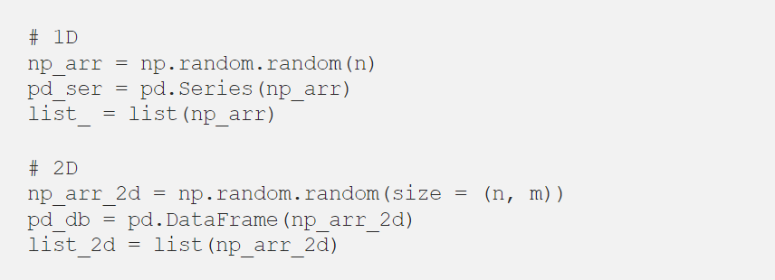

Slide 22
I used the built-in IPython magic function %timeit to find the average time each function took. The syntax is as below.
This returns a TimeitResult object that contains information on the best performance, average performance, standard deviations, number of runs, and number of loops it tested.
I tested the time to calculate mean, sum, and median for both row-wise and column-wise, as well as the time to query values using row numbers and column numbers.

Slide 23
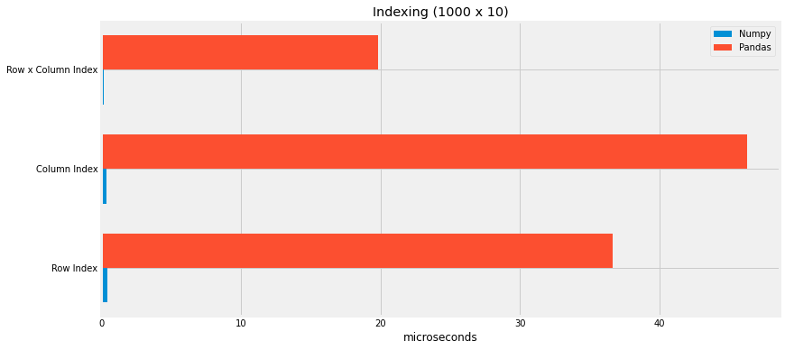
Querying with Index
Indexing for a small dataset

Slide 24
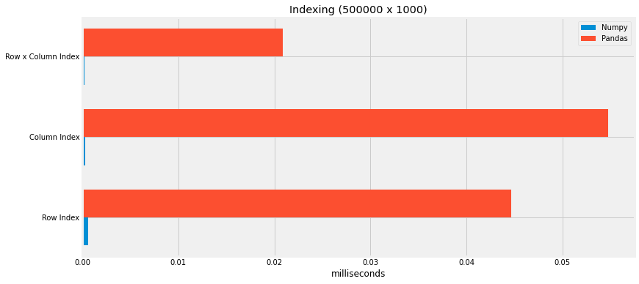
Indexing for a large dataset

Slide 25
When querying the dataset using the row numbers and column numbers, regardless of the size of a dataset, Numpy performed much better. But of course, Pandas allow indexing using column or row labels, which is a very useful feature regardless of the speed.

Slide 26
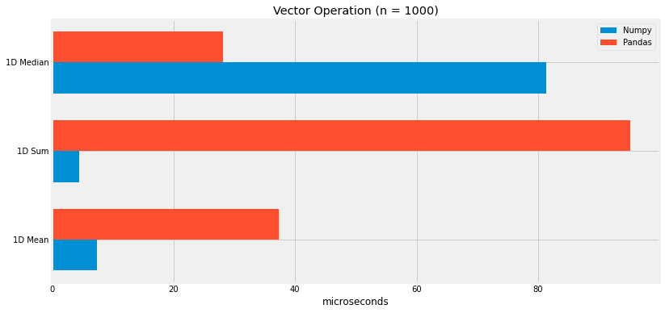
Vector Operation
Vector Operation on a small array (n = 1000)

Slide 27
When calculating straightforward arithmetic, such as summation and averaging, on vectors, Numpy again performed much better. But when it comes to computing the median, Numpy was shown to be quite slow. On the other hand, Pandas performed very well when computing a median.

Slide 28
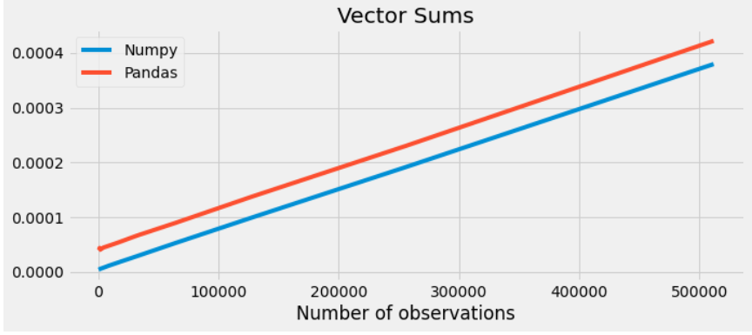

Slide 29
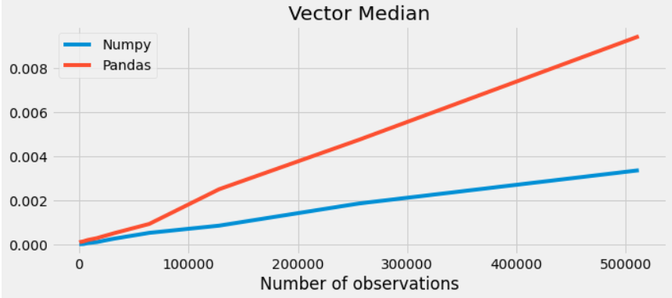

Slide 30
On a larger scale, the performance on summation was pretty similar for both Numpy and Pandas. But the median calculation started to get significantly worse for Pandas after about 60k rows.
Matrix Operation
Then I compared the column-wise and row-wise operations on a matrix in Numpy and Pandas data frame. Please note that the column size was consistent throughout, while the number of rows increased.

Slide 31
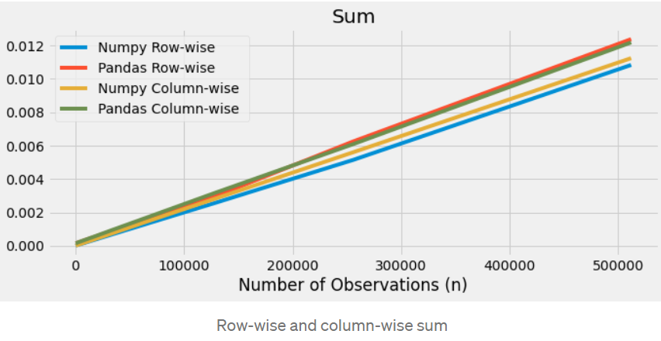

Slide 32
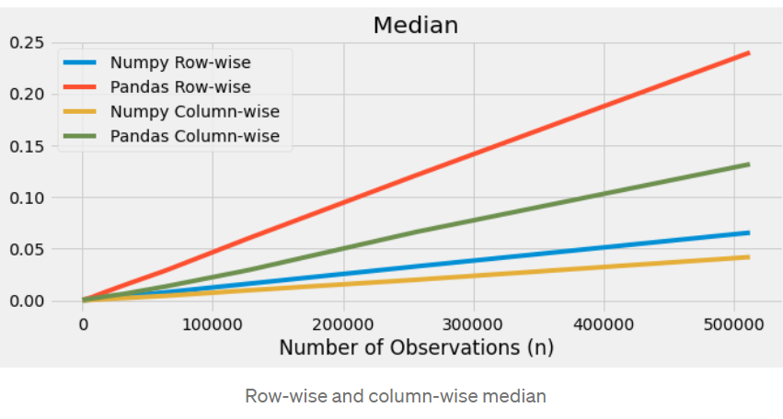
The results on the summation were pretty comparable between the two (not too surprisingly, as Pandas uses Numpy on its backend). For both, there was no advantage in computing row-wise vs. column-wise, even though the columns were not increasing.

Slide 33
PANDAS
Pandas started to suffer greatly at computing medians as the number of observations increased.
If we look closer into the smaller datasets, we can see that the Pandas performance on row-wise computation starts to decrease pretty early on.
But time on column-wise calculation grows at a slower rate. Considering how the number of columns is the same, Pandas seem to be more affected by indexing median in each iteration than Numpy.

Slide 34
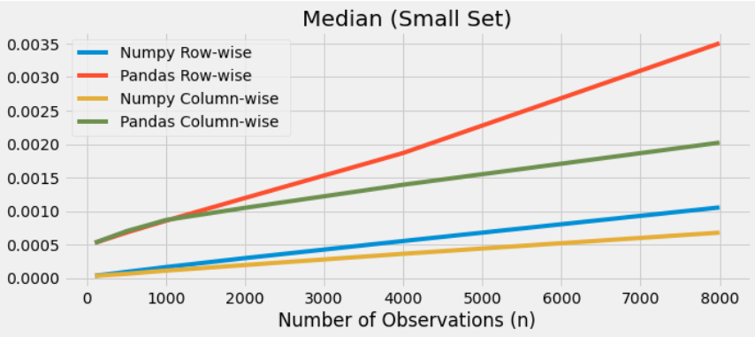

Slide 35
Here, we briefly compared the speed of Numpy and Pandas during the index-based querying, and the row-wise and column-wise arithmetic operations such as sum and mean as well as the median.
Numpy was faster than Pandas in all operations but was specially optimized when querying.
Numpy’s overall performance was steadily scaled on a larger dataset.
Pandas started to suffer greatly as the number of observations grew with exception of simple arithmetic operations.
Pandas is designed to enhance the group-level computation within the dataset using its indexing system.
Creating a Pandas data frame took over 6000 times longer than Numpy, with the extra time largely contributing to setting the index.

